Slide 1
Introduction to deep learning
28th of January 2025
Digital Skills

Slide 2
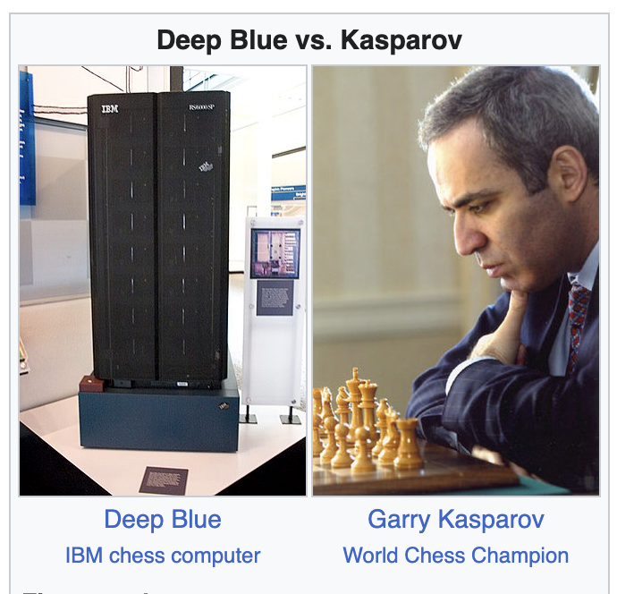
1996: Deep Blue vs Garry Kasparov

Slide 3
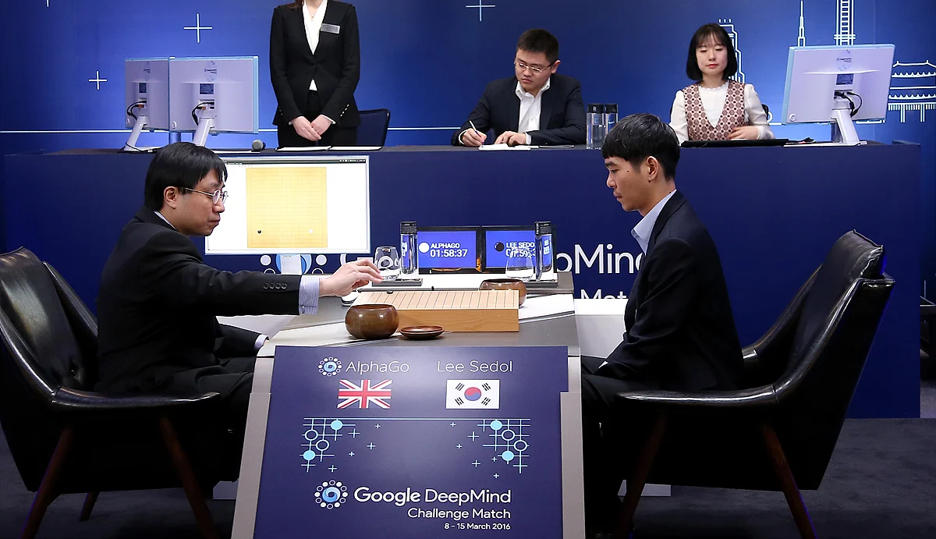
2016: AlphaGo vs Lee Sedol
Go has more possible states than there are atoms in the universe
Top players see it as an almost spiritual game where intelligence and reason collide with creativity and beauty.
Lee Sedol, the world champion at the time agrees to play AlphaGo in a match of humanity vs AI

Slide 4
2016: AlphaGo vs Lee Sedol, move 37
In the 2nd (out of 5) game it looks like Lee Sedol is winning, but then:
AlphaGo makes a move that has a 1 in 10.000 probability to be made by a human
Let’s look at Lee Sedol’s reaction: https://youtube.com/clip/UgkxHzdorhIIZCuweM2COVnZ_qvLz7zHzUFS?si=sWP2LFEMJiszoQjF
Book tip: The Maniac by Benjamín Labatut

Slide 5
Deep learning is a powerful technology that can (sometimes) master human intelligence

Slide 6
Deep learning is a powerful technology that can (sometimes) master human intelligence ….
… Let’s use it to do good science!

Slide 7
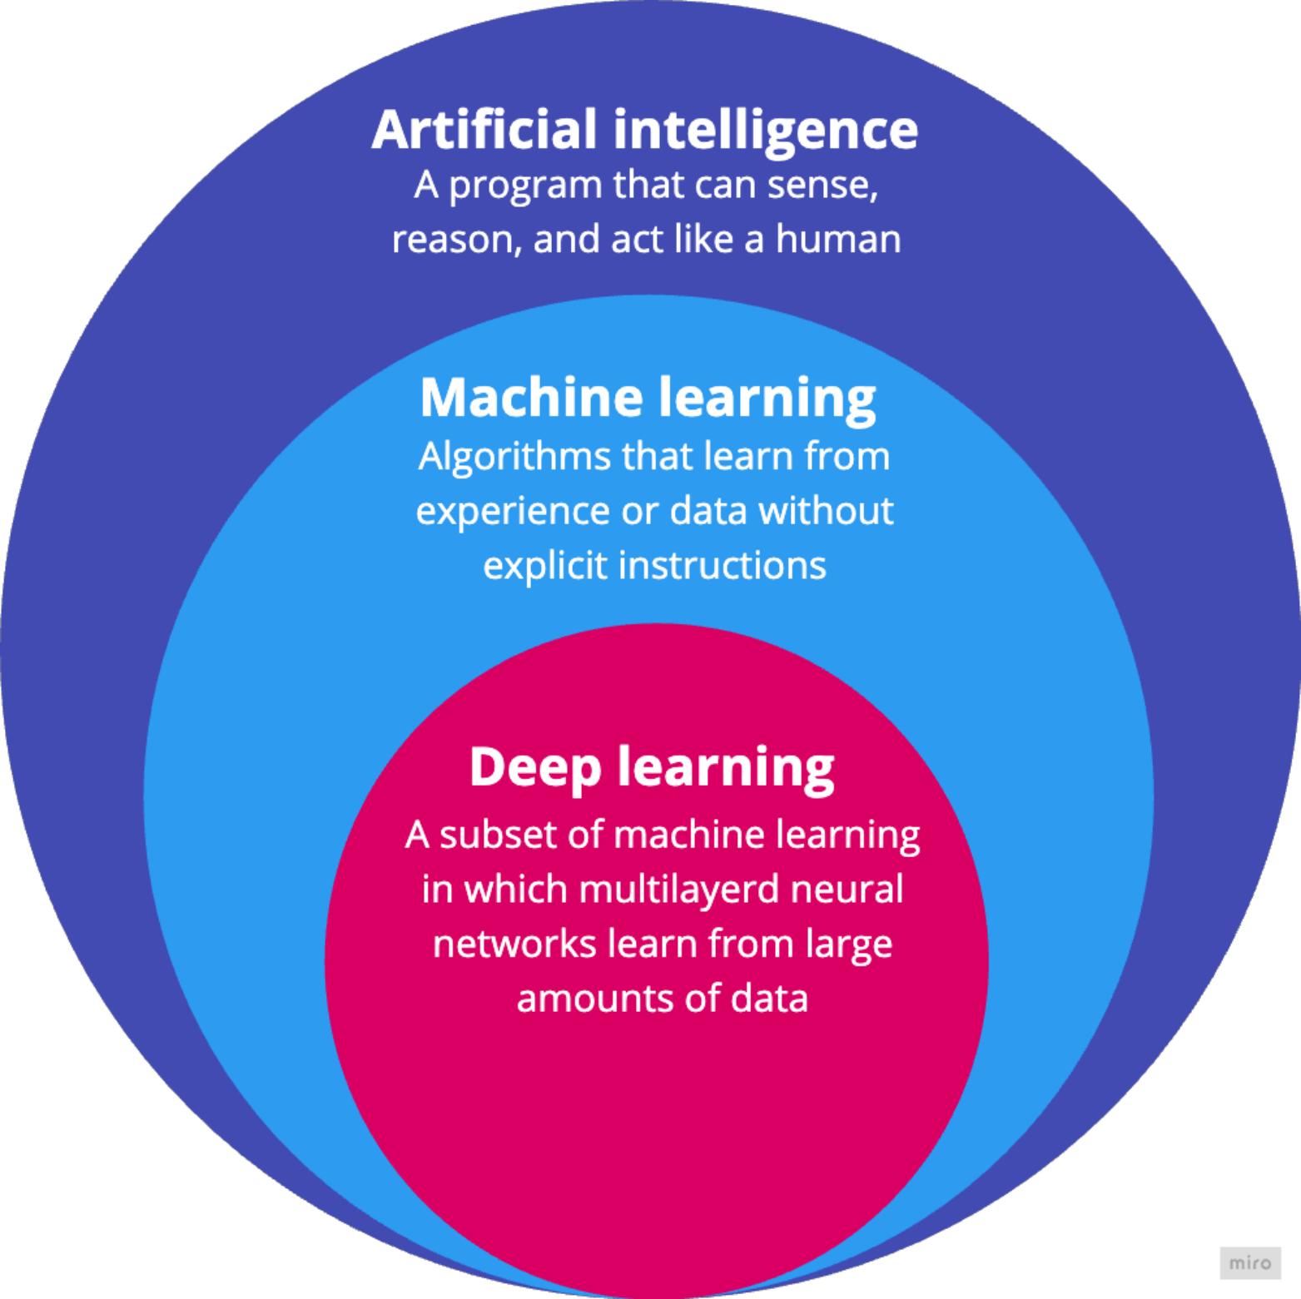
What is Deep Learning?

Slide 8
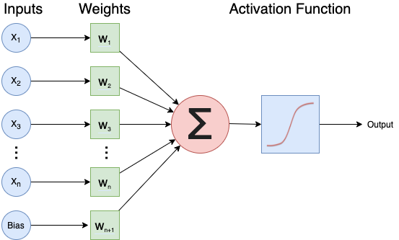
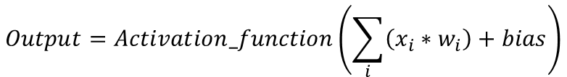
A single neuron in a neural network
$$Output=Activation_function\left(\sum_{i}{\left(x_{i}∗w_{i}\right)+bias}\right)$$

Slide 9
Exercise: activation functions
Look at 3 activation functions and answer the questions about them.

Slide 10
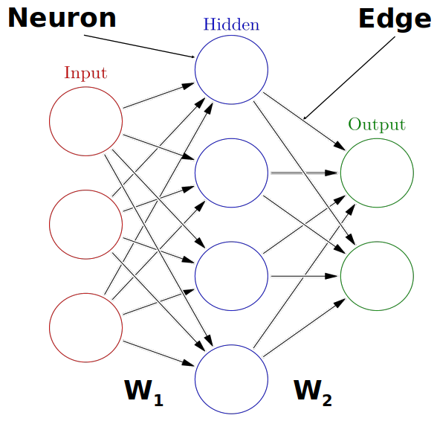
Neural Networks
https://playground.tensorflow.org/

Slide 11
Exercise: Calculate the output for one neuron

Slide 12
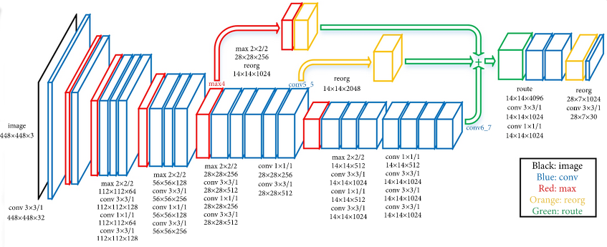
What makes deep learning deep learning?
“An Efficient Pedestrian Detection Method Based on YOLOv2” by Zhongmin Liu, Zhicai Chen, Zhanming Li, and Wenjin Hu, published in Mathematical Problems in Engineering, Volume 2018

Slide 13
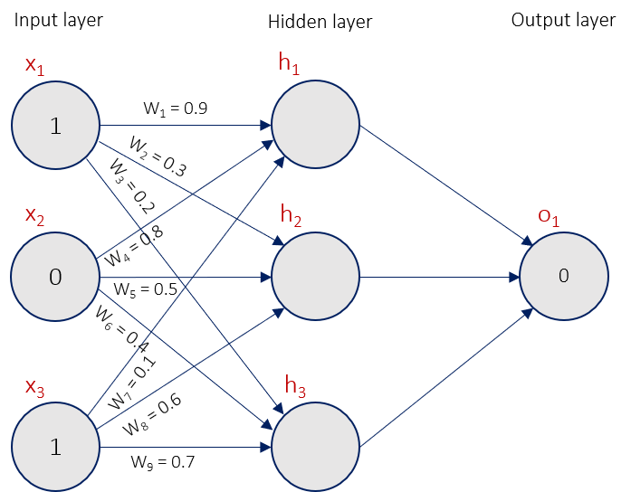
How do Neural Networks learn?
Loss Function
*Neural Network: A Complete Beginners Guide - Gadictos

Slide 14
Exercise: compute the mean squared error

Slide 15
What problems can deep learning solve?

Slide 16
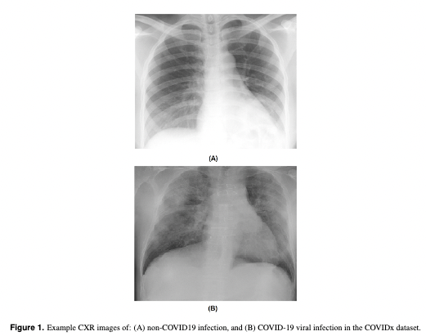
Pattern/object recognition
Example: Detecting COVID-19 in chest X-ray images

Slide 17
Segmenting images (or any data)
Example: Drawing circles around the parts of the body that are affected by COVID-19

Slide 18
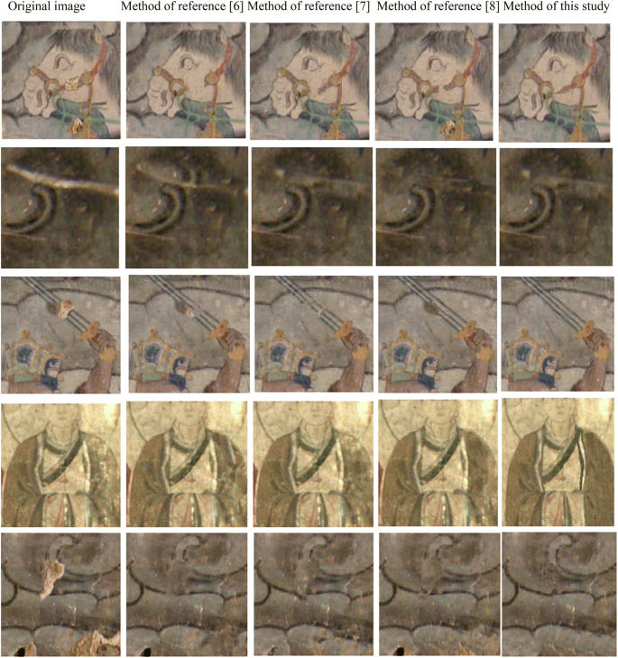
Generating new data that looks similar to training data: generative AI
Example: Ancient mural restoration based on a modified general adversarial network.

Slide 19
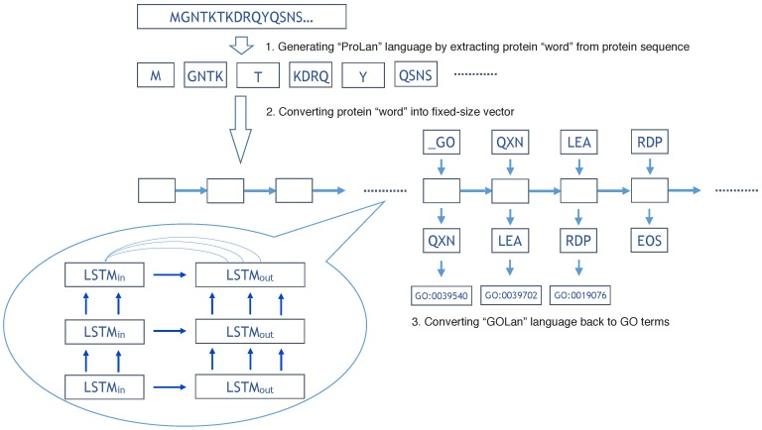
Translating between one set of data and another
Example: Translation from protein sequence language to protein function language.

Slide 20
What problem can deep learning not solve?
Any case where only a small amount of training data is available.
Tasks requiring an explanation of how the answer was arrived at.
Classifying things which are nothing like their training data.

Slide 21
When is it Overkill?
Logic operations, such as computing totals, averages, ranges etc. (see this example applying Deep Learning to solve the “FizzBuzz” problem often used for programming interviews)
Modelling well defined systems, where the equations governing them are known and understood.
Basic computer vision tasks such as edge detection, decreasing colour depth or blurring an image.

Slide 22
Exercise
Deep learning problems (see collaborative document)

Slide 23

How much data is enough data?
xkcd: Machine Learning

Slide 24
Deep Learning Workflow
Formulate/ Outline the problem
Identify inputs and outputs
Prepare data
Choose a pre-trained model or build a new architecture from scratch
Choose a loss function and optimizer
Train the model
Perform a Prediction/Classification
Measure Performance
Tune Hyperparameters
Share Model

Slide 25
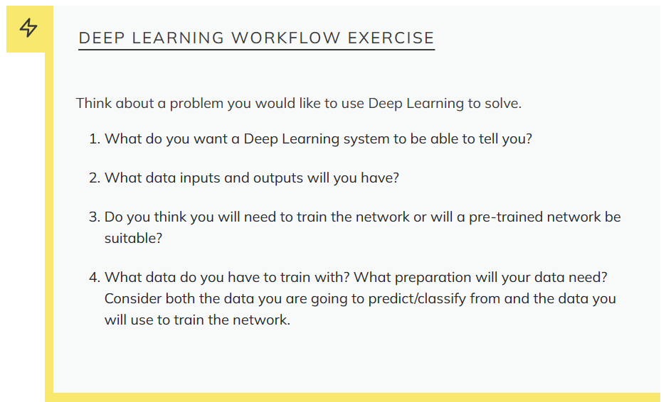

Slide 26



Deep Learning Libraries

Slide 27

Setup Testing

Slide 28
Outlook
A real-world application of deep learning in research
Organising deep learning projects
Discussion on large language models
Next steps

Slide 29
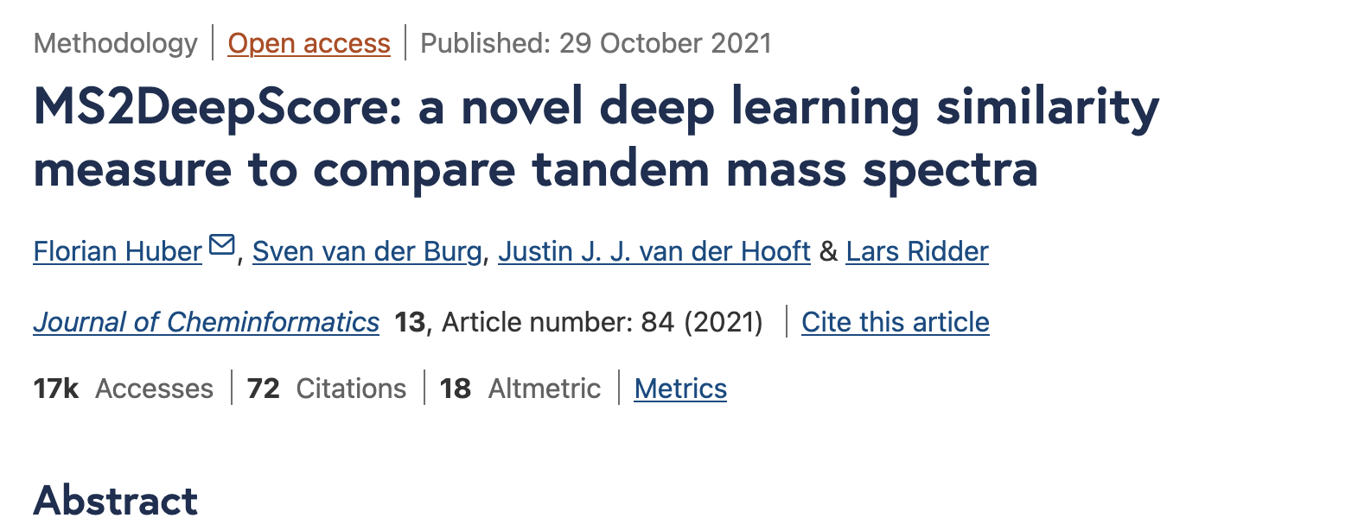
Real-world application of deep learning

Slide 30
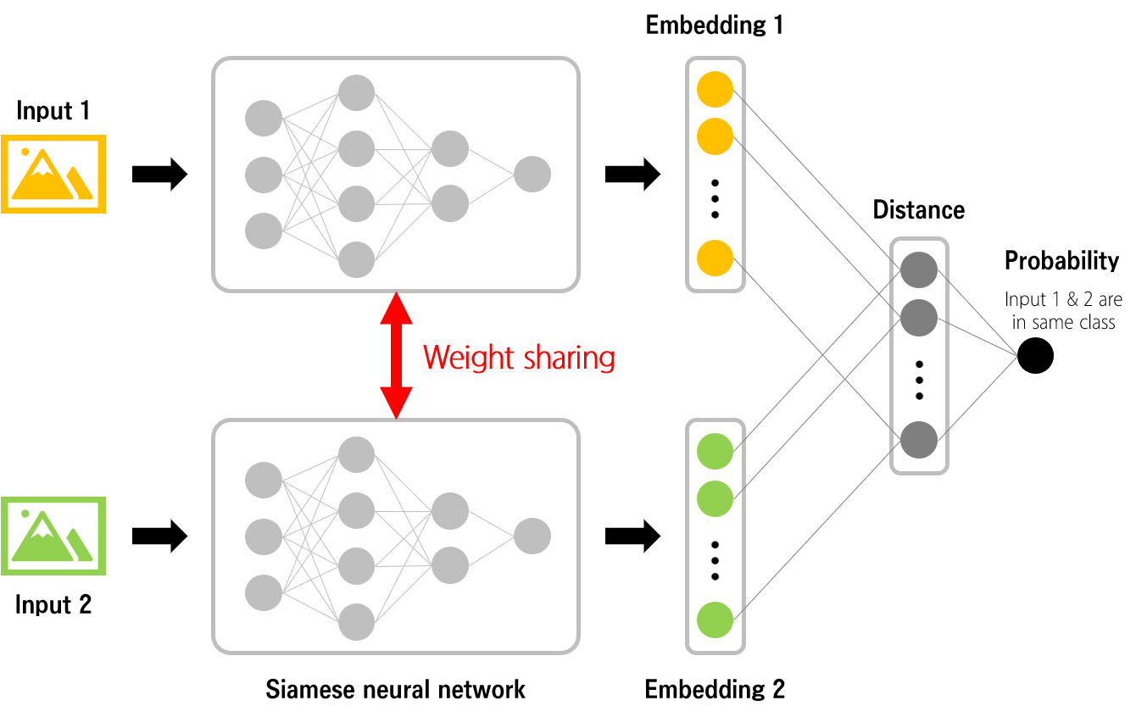
How similar are these mass spectrums?

Slide 31
Organizing deep learning projects

Slide 32
1. Organise experiments in notebooks
`01-all-cities-simple-cnn.ipynb`
Write a short rationale on top of each notebook

Slide 33
2. Use Python modules
Repeated code should not live in notebooks but in source code that is imported when needed

Slide 34
3. Keep track of your results in a central place
MODEL NAME | MODEL DESCRIPTION | RMSE | TESTSET NAME | GITHUB COMMIT | COMMENTS
weather_prediction_v1.0 | Basel features only, 10 years. nn: 100-50 | 3.21 | 10_years_v1.0 | ed28d85
weather_prediction_v1.1 | all features, 10 years. nn: 100-50 | 3.35 | 10_years_v1.0 | 4427b78

Slide 35
4. Keep your projects tidy
You can use a standard folder structure for your projects.
We recommend: Cookiecutter data science

Slide 36
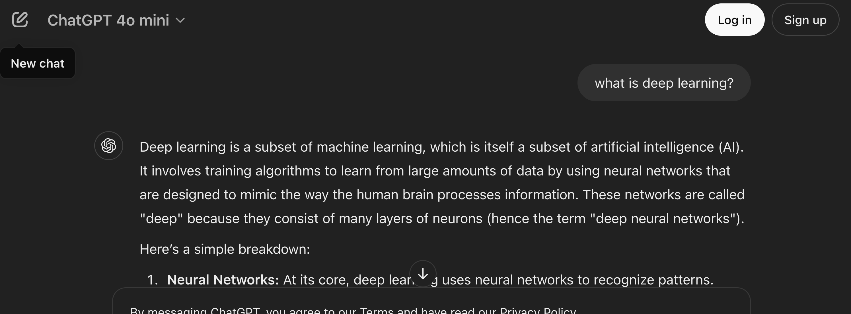
Large language models: ChatGPT

Slide 37
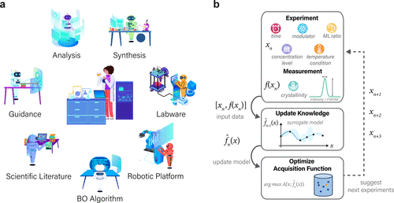
ChatGPT Research Group for Optimizing the Crystallinity of MOFs and COFs
Automation of extracting chemical information from a large amount of research articles.
Simplified prompt: Given compounds X and Y and context Z, what are the chemical details of the reaction?
Zeng et al. (2023)

Slide 38
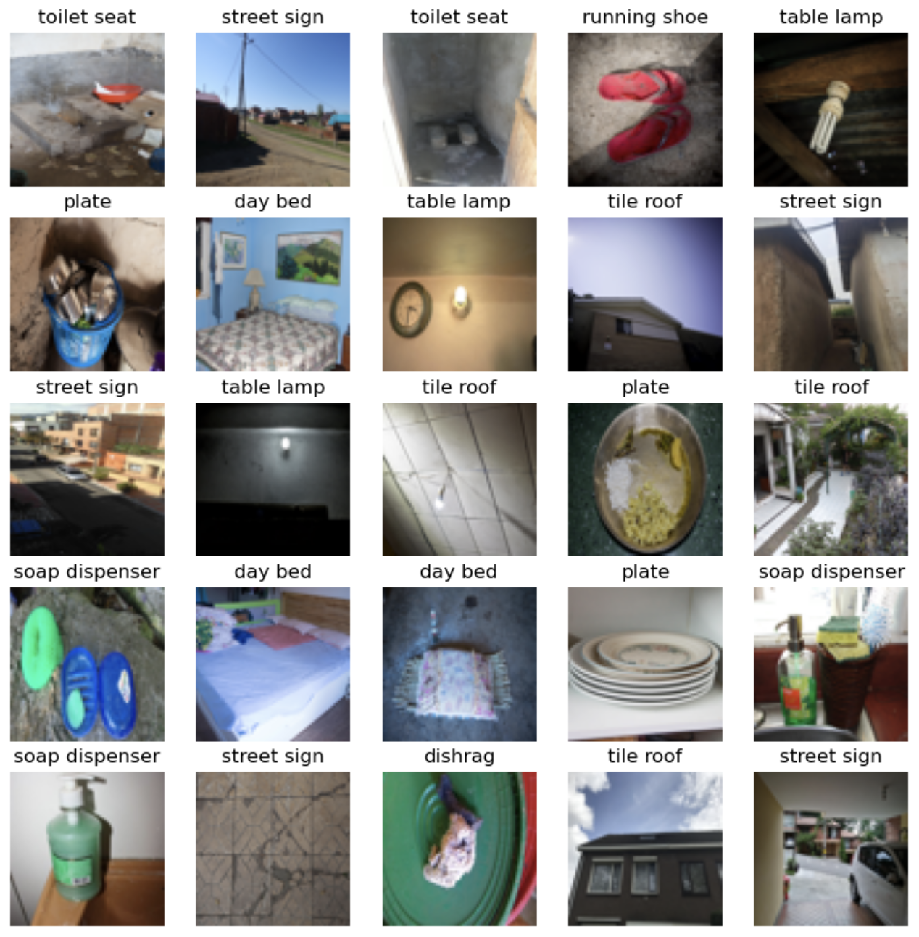
Solving Dollarstreet-10 with ChatGPT?
“Which out of these categories: [LIST OF CATEGORIES] is depicted in the image”.

Slide 39
Discussion
In a few years most machine learning problems in scientific research can be solved with prompt engineering.

Slide 40
Next steps
Check our further resources list
Apply what you learned in your own projects
Compete in a Kaggle competition
Get access to a GPU. Train in seconds instead of hours.

Slide 41
Congratulations! 🎉👍
You are now able to apply the basics of deep learning using Python

Slide 42
Deep learning is a powerful technology that can (sometimes) master human intelligence ….
… Let’s use it to do good science!

